Slide 1

Computer Organization and Assembly Language Lab
Lab 03
Defining Variables, Arithmetic Operations
National University of Computer and Emerging Sciences, Islamabad

Slide 2
What we studied in previous lab?
Registers
Directives
Addressing Modes
Assembly instruction
Program Structure, syntax and program to print a single character on screen

Slide 3
Today’s Agenda
In today’s lab, we will undergo the following topics:
Variables
Declaration of variables in data segment
Arithmetic Operations in assembly
Addition
Subtraction
Multiplication
Division
Tasks

Slide 4
Variables
What are variables?
Variables are used to store values.
The values of variable can be changed.
Where to initialize variables in assembly program?
Variables are defined in .data directive of program structure.
Naming Conventions for Variables
Do not use reserved keywords for variable names.
Reserved keywords are
Operands (ADD, SUB, MUL, DIV, MOV, POP, PUSH)
Registers (AX, BX, CX, DX, DS, CS etc)

Slide 5
Declaring Variables
How to initialize/declare variables in assembly program?
Variable name
Initializer Directive
Initializer
Initializer directive defines the size of data.
It is also known as Data type directive.
Initializer is the value of variable.
Example:
VAR1 DB 49 ; Declare a byte, referred to as location Var1, containing the value 49
VAR2 DB ‘A’ ; Declare a byte, referred to as location Var1, containing the value 65
VAR3 DB ? ; Declare an uninitialized byte, referred to as location Var3
Where DB stands for Define Byte.

Slide 6
Initializer Directives (Data Size)
NAME | STAND FOR | SIZE
DB | Define Byte | 1 Byte/8 Bits
DW | Define Word | 2 Bytes/16 Bits
DD | Define Double Word | 4 Bytes/32 Bits
DQ | Define Quad Word | 8 Bytes/64 Bits
DT | Define Ten Bytes | 10 Bytes/80 Bits

Slide 7
Variable Declaration in Program
.DATA
VAR DB 49
.CODE
MOV AX,@DATA ; initialization of data segment to register ax
MOV DS,AX ; copy the addresses in ds
MOV DL, VAR

Slide 8
String Declaration in Program
.DATA
STR1 DB “Lab 3”, ‘$’
.CODE
MOV AX,@DATA ; initialization of data segment to register ax
MOV DS,AX ; copy the addresses in ds
MOV DX, offset str1

Slide 9
String Operations
Offset: Returns distance of a variable from the beginning of its segment
Type: Returns an integer representing size of a variable. E.g., TYPE of word is 2
Length: Counts number of individual elements in a variable that has been defined using Dup
Size: It determines the total bytes occupied by a variable that has been defined using Dup
DUP: Allows a sequence of storage locations to be defined or reserved

Slide 10
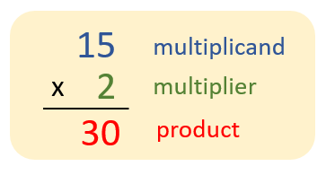
Multiplication

Slide 11
Multiplication in Assembly
MUL operand 1
Multiply operand1 with contents placed in register AL
Example
MOV AL, 3 ; 3 is multiplicand
MOV BL, 2 ; 2 is multiplier
MUL BL ; BL will be multiplied to AL and product will be stored in AX

Slide 12
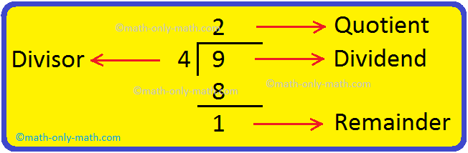
Division

Slide 13
Division in Assembly
DIV operand 1
o when operand is a byte: AL = AX / operand , AH = remainder
Example
MOV AX, 21 ; 21/4 where 21 is dividend.
MOV BL, 4 ; 4 is divisor
DIV BL ; it divides 21 by 4 and stores quotient in AL = 5 and remainder in AH = 1

Slide 14
Tasks
Write Assembly program to add two numbers using variables.
Write Assembly program to subtract two numbers using variables.
Write Assembly program to multiply two numbers using variables.
Write Assembly program to divide two numbers using variables.
Declare and initialize array of your choice and store its length, size and type in separate variables.

